Slide 1
Fitness app using Azure Data Studio
Presented by
-Pasupuleti Rohith Sai Datta
-Chinmaya D Kamath

Slide 2
Introduction
Everyone today dreams of a healthy life cycle. However, in today's hectic world, they are unable to reach their full potential due to unhealthy eating habits and a lack of proper physical exercise.
A balanced diet is necessary, as your organs and tissues need proper nutrition to work effectively. Without good nutrition, your body is more susceptible to disease, infection, fatigue, and poor performance.
A balanced diet consists of foods that are low in unnecessary fats and sugars and high in vitamins, minerals, and other nutrients.
Calories play a vital role in our growth and energy.
A good diet can help you manipulate calorie intake based on your needs.

Slide 3

Motivation
Health at Your Fingertips
Seeking guidance from traditional dieticians can be challenging in our fast-paced lives. Fitness app using Azure Data Studio and exercise consultant application revolutionizes convenience by eliminating the need for in-person consultations. You can now access personalized diet plans and physical challenges anytime, anywhere, making it easier than ever to prioritize your health and well-being.

Slide 4

Motivation
Your Path to Success
With this application, achieving your fitness goals becomes more attainable than ever. By analyzing your progress and adjusting recommendations accordingly, the AI-powered system keeps you on track towards sustainable results. It helps you build healthy habits that extend beyond short-term changes, ensuring long-term success and improved overall well-being.

Slide 5
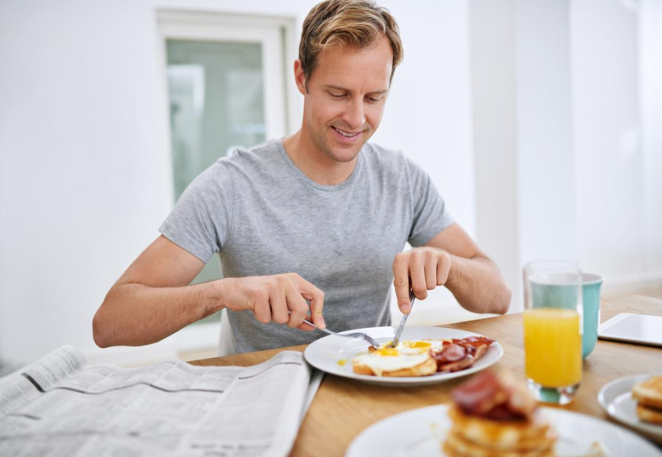
Motivation
A Healthier Tomorrow
The development of an Fitness app using Azure Data Studio and exercise consultant application holds immense promise in addressing the prevalent health issues of our time. By embracing this innovative approach, we can collectively combat the negative impacts of unhealthy eating habits and sedentary lifestyles. Together, let's pave the way for a healthier, more fulfilling future.

Slide 6
Objectives
Objectives of our Fitness app using Azure Data Studio Application are –
To calculate BMI and BMR, the application must accept user inputs such as Height and Weight and then generate a diet using artificial intelligence from the food dataset.Using artificial intelligence, the application should be able to generate the exercises as well as the diet.
To promote a healthy and fit lifestyle, the application should suggest exercises based on the user's BMI and BMR, utilizing artificial intelligence.If the user is not physically active enough to walk and drink water throughout the day, the app must send notifications.
To provide comprehensive health tracking, the application will sync and display various health metrics from Google Fit, including Steps, Heart Rate, Blood Pressure, Oxygen Saturation, Blood Glucose, and Body Temperature.

Slide 7
Objectives
To encourage physical activity, our application will analyse the user's steps and send notifications if they need to walk more. The application will also remind the user to stay hydrated by sending notifications to drink enough water daily. The app will save the user's steps and water intake data for one week of analysis.
To provide diet related answers our application consists of a chatbot where the chatbot responds to the user's questions based on artificial intelligence by using Dialogflow essentials
To promote a healthy lifestyle, our application suggests workout training and motivational videos to users to help them maintain good health.

Slide 8
Methods and Methodology
Generating Diet
Method: The new user must sign up and the old user must log in in order to use the application. After registration, the user must enter his user details, such as height and weight, to calculate the BMI and BMR.
Methodology: Research and choose a reliable formula to calculate BMI and BMR, and ensure that the application includes a validation process to check the input data for accuracy.
Generating Exercises
Method: The application uses artificial intelligence algorithms to suggest exercises for the user based on their BMI and BMR.
Methodology: It chooses the machine learning algorithm that can analyse user data and generate a list of recommended exercises for the user. Ensure that the application includes a variety of exercise options to choose from.

Slide 9
Methods and Methodology
Synchronizing Google Fit data
Method: The application uses the Google Fit API to sync and display various health metrics such as Steps, Heart Rate, Blood Pressure, Oxygen Saturation, Blood Glucose, and Body Temperature.
Methodology: Use the step data to send notifications to the user to walk more, and reminders to stay hydrated.
Active Notifications
Method: The application uses the step data to send notifications to the user to walk more, and reminders to stay hydrated, training & Motivational Videos
Methodology: Develop a notification system that can analyse the user's step data and send notifications accordingly. Ensure that the notifications are not intrusive and can be customized to suit the user's preferences.

Slide 10
Methods and Methodology
Chatbot
Method: The application consists of a chatbot where the chatbot responds to the user's questions based on artificial intelligence by using Dialogflow essentials
Methodology: Chat bot responds to the user questions based on intents and knowledge-based data which is trained for it.
Training & Motivational Video
Method: The application uses artificial intelligence algorithms to suggest workout training and motivational videos to the user.
Methodology: It uses a machine learning algorithm that can analyse user data and generate a list of recommended workout training and motivational videos. Ensure that the videos are high-quality and are tailored to the user's preferences and fitness level.

Slide 11
Technologies used
Front End: XML
Back End: Azure Data Studio
Programing Language: Java
IDE: Android Studio

Slide 12
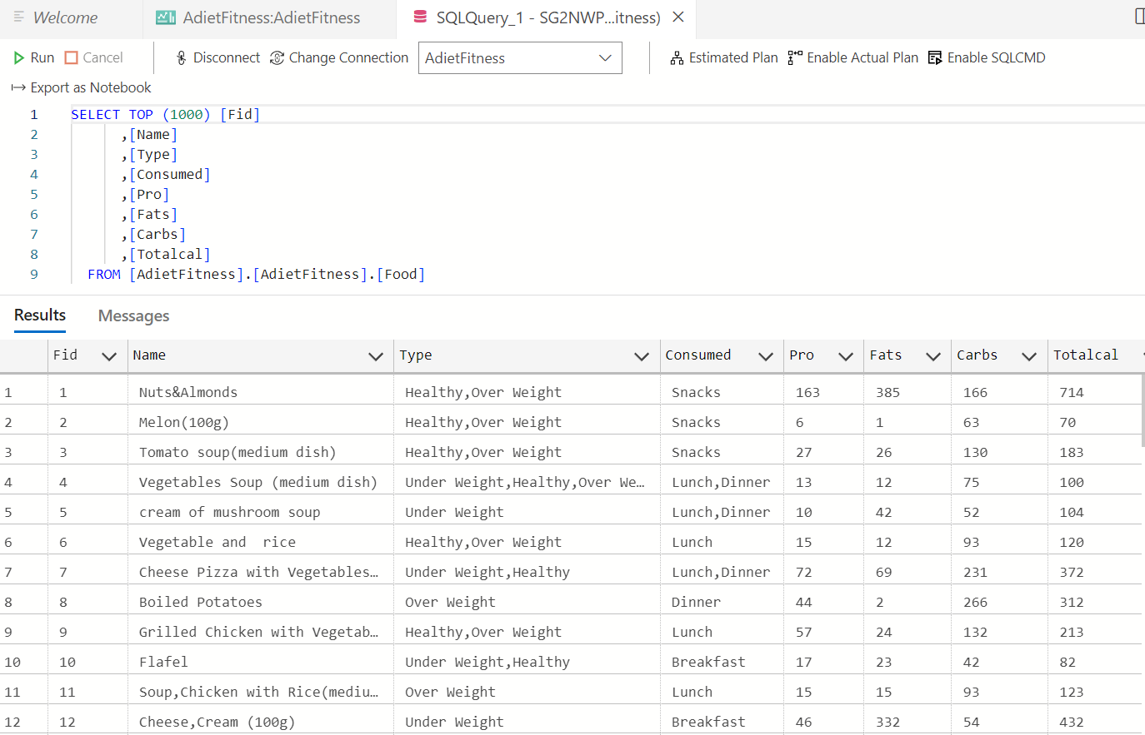
Azure Data Studio
We utilized Azure Data Studio as our database management tool. Additionally, we have curated a collection of food datasets

Slide 13
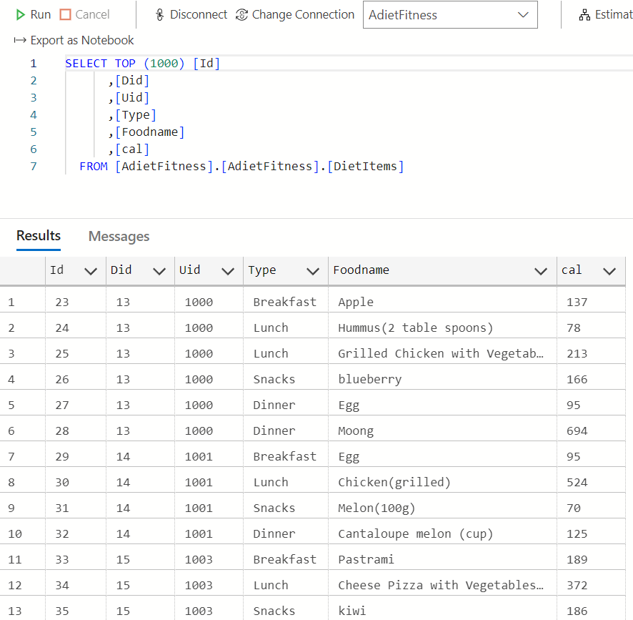
Azure Data Studio
The following diet items are generated for the user:
Breakfast
Lunch
Snacks
Dinner

Slide 14
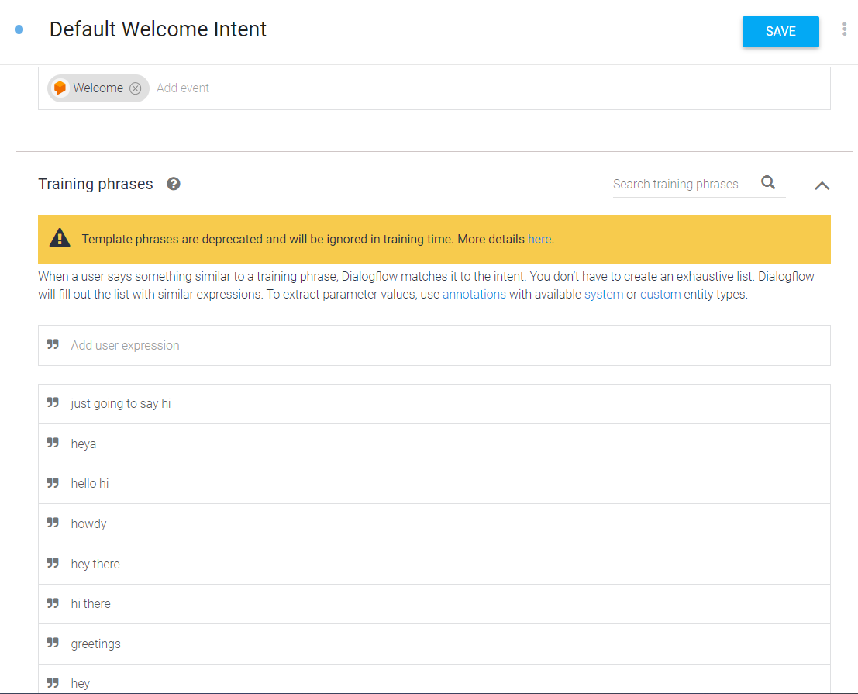
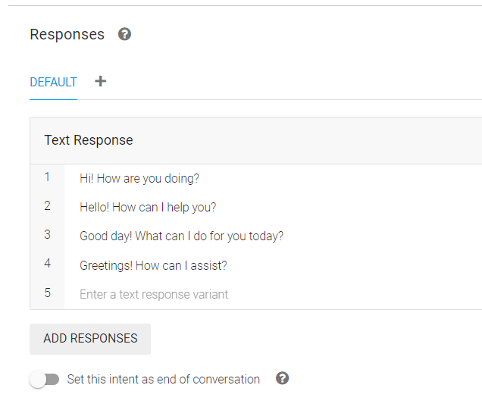
Dialogue flow Essentials
The Dialogue Flow Essentials will enable the Chat Bot to effectively respond to user questions. Within the system, Training Phrases and Responses have been created as part of the welcome intent

Slide 15
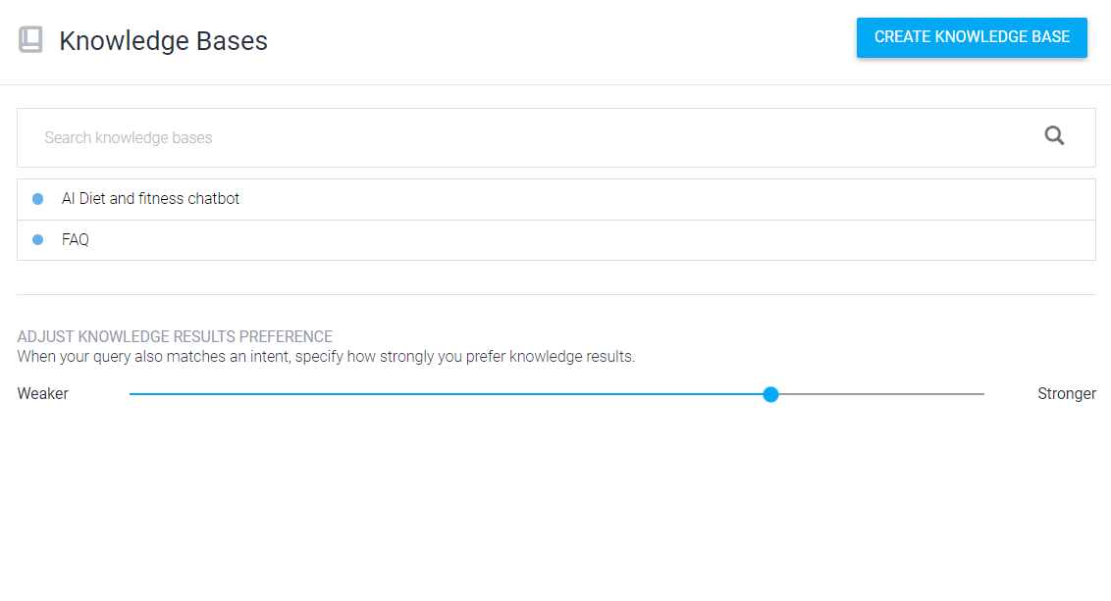
Dialogue flow Essentials
In Dialogue flow Essentials a knowledge base is like a collection of information for the chatbot. It has questions and answers to help the chatbot give accurate responses. It's useful for handling common questions and providing reliable information.

Slide 16
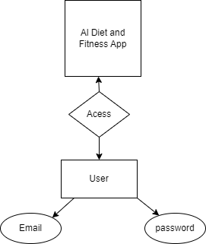
Design
E-R Diagram

Slide 17
Activity Diagram

Slide 18
Thank You

